Slide 1
Gradient Descent and Regularization Simplified

Slide 2
Functions used
H(x) = W1*X1 + W2*X2 +….+Wn*Xn in case of Linear Regression
Error Function: (SUM( H(X[i]) – y[i]) ^ 2) * (1/n)
X,y -> parameters and dependent variable.
When we substitute X and y values from i=1 to n in the error function, the error function now is only dependent on W1,W2,…. And Wn. Everything else is a number.
These means we have to solve Error Function/Cost Function for values of W1,W2,……Wn where Cost Function achieves minima.

Slide 3
Achieving Minima
As described in the previous slide, we have to achieve minimum of cost(error) function.
We find slope of cost function at each iteration. The slope is also known as the derivative of cost function with respect to its independent variables.
So we have n values of n derivatives of cost function w.r.t. W1,W2,Wn.
These are d/dW1(cost func.),d/dW2(cost func.)
Now at every step, W1 gets reduced to W1 = W1 – d/dW1(cost func.) and so on for each Weight
Now if slope is high means it is away from minimum, so W1 reduces faster.
When slope starts getting lesser and lesser, means it is close to a minimum point of cost function and W1 is reduced less.

Slide 4
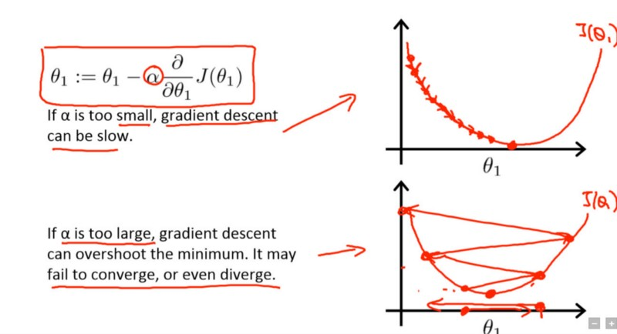
Learning Rate(alpha)
big alpha means missing the minima easily.
Small alpha means taking too long.
So we have to choose this multiplicative hyper parameter carefully.

Slide 5
Regularization
We saw the cost function which is a function dependent on W1,W2,…Wn.
Now in addition to the MSE ( mean squared error) which was (SUM( H(X[i]) – y[i]) ^ 2) * (1/n), we now will also add to it lambda*(W1*W1 + W2*W2+W3*W3+…….+Wn*Wn).
What do we achieve with this you ask?
We reduce overfitting. But How?
Now your gradient descent has to find weights which are not only at a minimum point but also reduce lambda.
So if you set lambda as high such as 20,50,100 or so on, the GD will try to reduce W1,W2,…Wn based on their impact on Y accordingly.

Slide 6
Regularization
If Weight of W1 is higher in prediction of H(x), then W1 is reduced more by lambda and so on for each weight.
Final H(x) function(model) is more generalized and less overfitting.

